Slide 1

Week #6
AI Academy®
1
Day 1:
What is Product Hunting?
Customer Criteria & Demands
Manage Product Sourcing
Reviews & Feedbacks

Slide 2
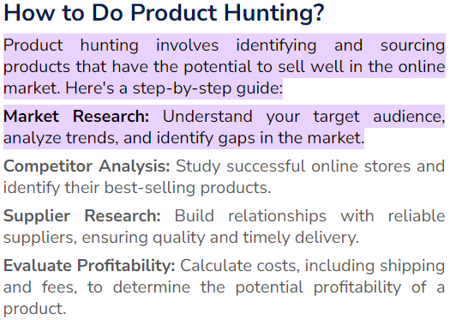
Week #6
AI Academy®
2

Slide 3
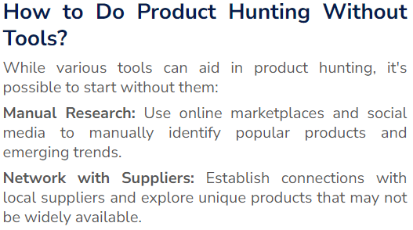
Week #6
AI Academy®
3

Slide 4
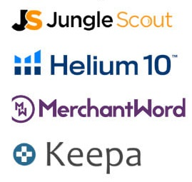
Week #6
AI Academy®
Best tools for Product hunting:
4

Slide 5
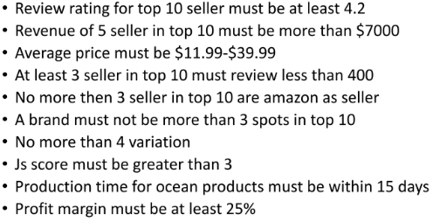
Week #6
AI Academy®
5

Slide 6
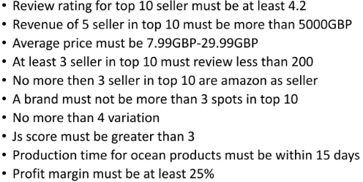
Week #6
AI Academy®
6

Slide 7
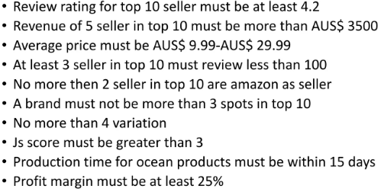
Week #6
AI Academy®
7

Slide 8
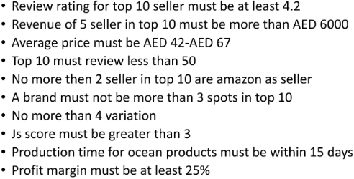
Week #6
AI Academy®
8

Slide 9
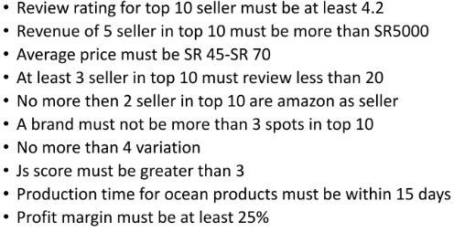
Week #6
AI Academy®
9

Slide 10
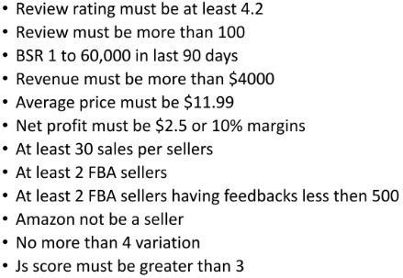
Week #6
AI Academy®
10

Slide 11
Week #6
AI Academy®
11
Day 2:
Different Strategies & Techniques for Local & Global Market Research
Various Criteria and Tools
Reviews & Feedbacks

Slide 12
Week #6
AI Academy®
12
Searching Techniques:
Keyword Search like, Cup, Coffee Cup, etc.
See Best Sellers, or Hot winning Products
Today Deals
Top Product Reviews
Use tool of Helium10, JS, etc.
See Discounts, Offers, Coupons.

Slide 13
Week #6
AI Academy®
13
Day 3:
Identify or Define Criteria Evaluation
Set Viability for Products
Set Profitability for Product
Reviews & Feedbacks

Slide 14
Week #6
AI Academy®
14
Day 4:
Defining & Selecting Profitable Suppliers
Local & Global
Winning Products Criteria
Reviews & Feedbacks

Slide 15
Week #6
AI Academy®
15
Suppliers local:
DARAZ
Global Suppliers:
ALIEXPRESS
ALIBABA
1688.com
WALMART
CJ DROPSHIPPING

Slide 16
Week #6
AI Academy®
16
Day 5:
Testing Product
Validating Product
Before launch
Reviews & Feedbacks

Slide 17
Week #6
AI Academy®
Suppliers local:
Product testing is figuring out what a product is, how it is made, or how well it works. This helps companies make sure that their products meet the needs of a wide range of customers before they start making them.
Quality Assurance
Concept Testing
A/B Testing
Avoid Making Assumptions
17

